Slide 1
Getting Started with RAZOR

Slide 2
Remember the views?
They are html templates that allow us to embed c# code using the Razor syntax
The Razor syntax is based on the C# programming language, and that's the language that's used most often with ASP.NET MVC. However, the Razor syntax also supports the F# & Visual Basic languages, and everything you see you can also do within them.
The idea behind Razor is to provide an optimized syntax for HTML generation using a code-focused templating approach, with minimal transition between HTML and code. The design reduces the number of characters and keystrokes, and enables a more fluid coding workflow by not requiring explicitly denoted server blocks within the HTML code

Slide 3
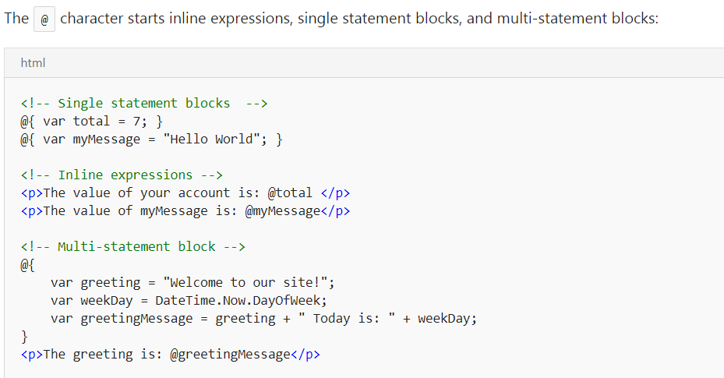
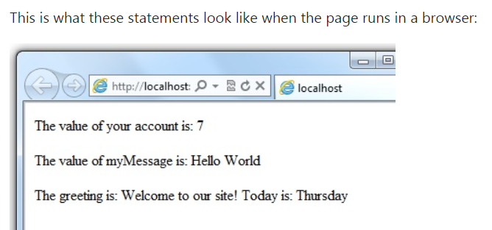
How to add Razor code in views
What is cool is that in a Razor view
Template, you can switch back and
Forth between html and C# easily

Slide 4
Using Variables
You create a new variable using the var keyword. You can insert variable values directly in a page using @.
<!-- Storing a string -->
@{ var welcomeMessage = "Welcome, new members!"; }
<p>@welcomeMessage</p>
<!-- Storing a date -->
@{ var year = DateTime.Now.Year; }
<!-- Displaying a variable -->
<p>Welcome to our new members who joined in @year!</p>

Slide 5
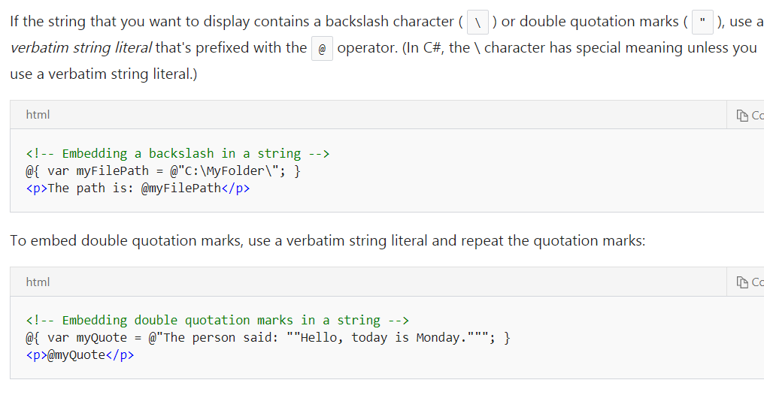
Literal Strings
You enclose literal string values in double quotation marks

Slide 6
Other Notes
Code is case sensitive
Much of your code will involve objects
Most of what you know about coding in C# will work within Razor
If you are coding Razor templates that use the C# language the file extension will be .cshtml

